Slide 1
Computer Applications to Behavioral Sciences
Lecture 11. Excel File Processing
https://psychology-courses.appspot.com/
Dr. Jibo He
Wichita State University
hejibo@gmail.com

Slide 2

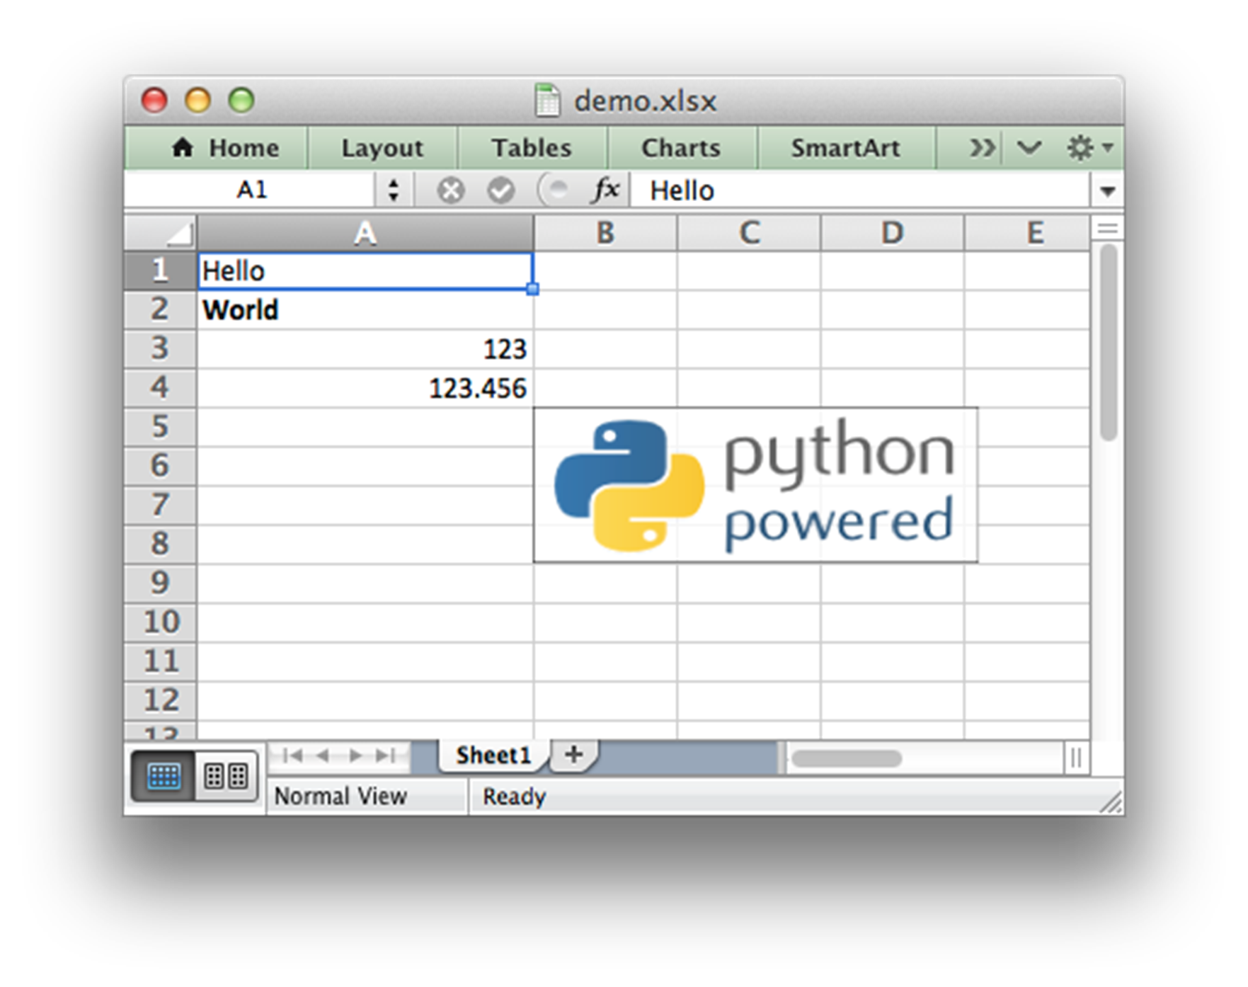
File Processing

Slide 3
Python Modules for Excel Processing
Xlrd
reading data and formatting from .xls files
• http://pypi.python.org/pypi/xlrd
Xlwt
writing data and formatting to .xls files
https://pypi.python.org/pypi/xlwt
xlutils
http://pypi.python.org/pypi/xlutils
• a collection of utilities using both xlrd and xlwt:
◦ copying data from a source to a target spreadsheet
◦ filtering data from a source to a target spreadsheet

Slide 4
Python Modules for Excel Processing
XlsxWriter
https://xlsxwriter.readthedocs.org/
XlsxWriter is a Python module that can be used to write text, numbers, formulas and hyperlinks to multiple worksheets in an Excel 2007+ XLSX file. It supports features such as formatting and many more, including:

Slide 5
Install Python packages
Install using .exe
xlrd-0.7.1.win32.exe
https://pypi.python.org/pypi/xlrd/0.7.1
Install from source:
C:\> cd xlrd-0.7.1
C:\xlrd-0.7.1> python setup.py install

Slide 6
Import modules
from mmap import mmap,ACCESS_READ
from xlrd import open_workbook
Import xlrd

Slide 7
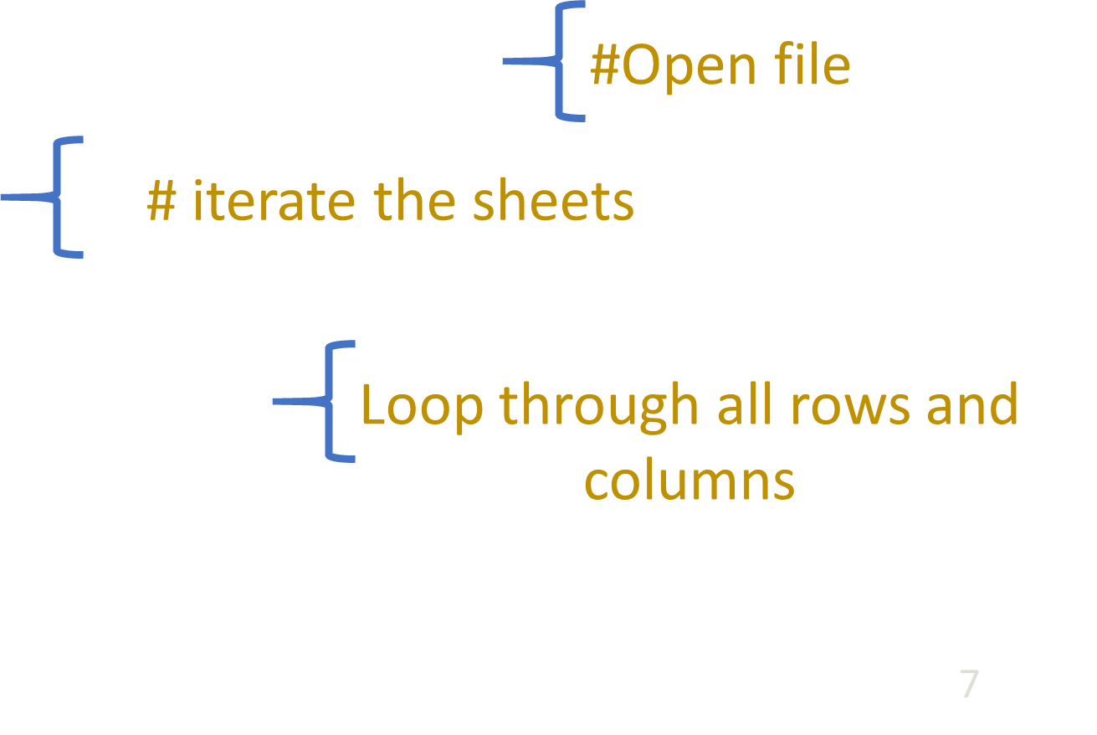
Open an Excel File
import xlrd
from xlrd import open_workbook
wb = open_workbook('simple.xls')
for s in wb.sheets():
print 'Sheet:',s.name
for row in range(s.nrows):
for col in range(s.ncols):
print s.cell(row,col).value

Slide 8
Open an Excel File
import xlrd
- xlrd is the package to read excel files.
wb = open_workbook('simple.xls')
- open a workbook
s.nrows, s.ncols
- get the number of rows and columns
s.cell(row,col).value
- get the value at cell location of (row,col)

Slide 9
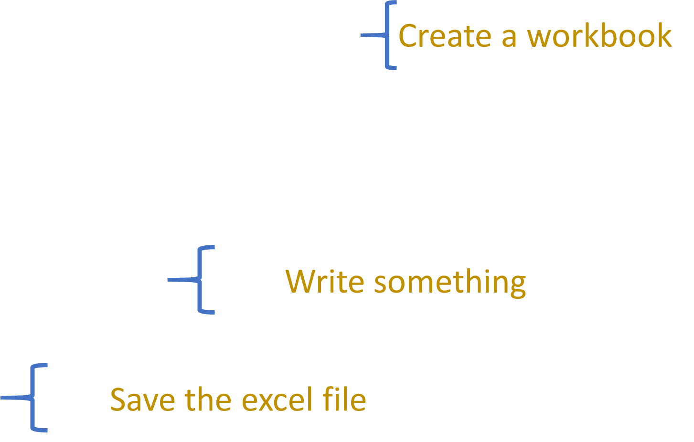
File Handle as a Sequence
import xlwt
book = xlwt.Workbook(encoding="utf-8")
sheet1 = book.add_sheet("ShowMeThePower")
sheet1.write(0, 0, "Python is Great!")
sheet1.write(1, 0, "Dominance")
sheet1.write(2, 0, "Test")
book.save("trial.xls")
print '-_-!'

Slide 10
Write a lot
import xlwt
- python package to write an excel file
book = xlwt.Workbook(encoding="utf-8")
- create a workbook
sheet1 = book.add_sheet("ShowMeThePower") - create a sheet called “ShowMeThePower”
sheet1.write(0, 0, "Python is Great!")
- write at A1 of the excel
book.save("trial.xls")
- save the excel file

Slide 11
Write a lot
import xlwt
book = xlwt.Workbook(encoding="utf-8")
sheet1 = book.add_sheet("ShowMeThePower")
for row in xrange(1,10):
for col in xrange(1,10):
sheet1.write(row, col, row*col)
book.save("WriteAlot.xls")
print '-_-!'

Slide 13
Summary
Install python packages
Import a python package
Import xlrd
Read an excel file
Write an excel file

Slide 14
Thank You

